Slide 1
NOISE POLLUTION MONITORING

Slide 2
GROUP MEMBERS
BHUVANESWARAN. S(leader)
ARUNTHDEVI. M
DIVYA. M
DHIVYA. B
JAYASATHYA. R
KALAIYARASI. E

Slide 3
ABSTRACT
Noise pollution is unwanted sound, it needs to be controlled to make the workplace comfortable.
This chapter analyses noise mathematically and the effects of multiple sources are examined.
Two noises of exactly the same level can have a combined noise level that is 3 dB higher than the individual values.

Slide 4
INTRODUCTION
Noise pollution is considered to be any unwanted or disturbing sound.
That affects the health and well-being of humans and other organisms.
An IoT-based air and sound pollution monitoring system is implemented using a network of sensors, connectivity technologies, and data analytics platforms.
Air quality sensors are deployed in strategic locations to measure pollutant levels such as particulate matter, gases, and volatile organic compounds (VOCs).

Slide 5
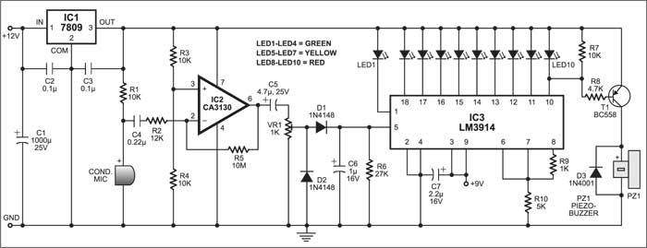
CIRCUIT DIAGRAM

Slide 6
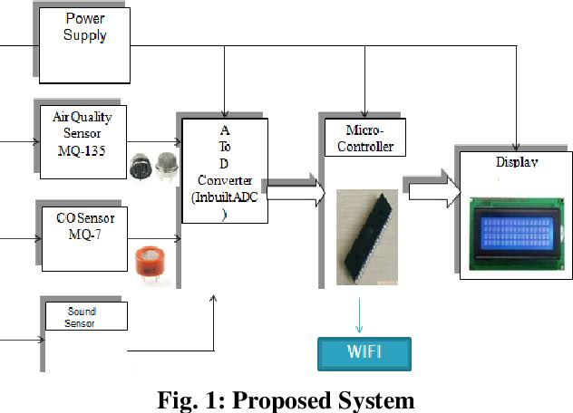
BLOCK DIAGRAM

Slide 7
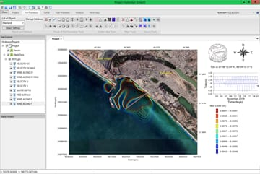
SIMULATION SOFTWARE

Slide 8
CUSTIC is a software for noise pollution modeling.
The program calculates the noise level in each point of the space considering each one of the sources.
The conditions of the atmosphere.

Slide 9
EXISTING MODEL
An IOT -based air and sound pollution monitoring system.
It is implemented using a network of sensors, connectivity technologies, and data analytics platforms.
Air quality sensors are deployed in strategic locations to measure pollutant levels such as particulate matter, gases, and volatile organic compounds (VOCs).

Slide 10
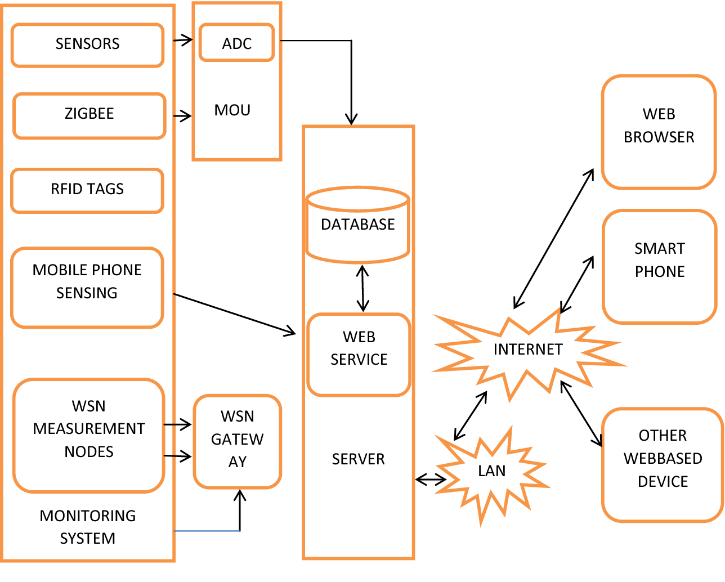

Slide 11
RELATED WORK
This allows authorities to monitor air pollution in different areas and take action against it.
Also authorities can keep a watch on the noise pollution near schools, hospitals and no honking areas.
And if system detects air quality and noise issues it alerts authorities so they can take measures to control the issue.

Slide 12
PROPESED MODEL
It uses (Sound sensor LM393) that detects noise levels and responds appropriately by glowing the LEDs.
When the sound limit exceeds a certain high limit, a buzzer also turns on along with the LEDs.
In this proposed system Node MCU, LED, Buzzer, Sound sensor is used.
Arduino IDE is the coding software utilized.

Slide 13
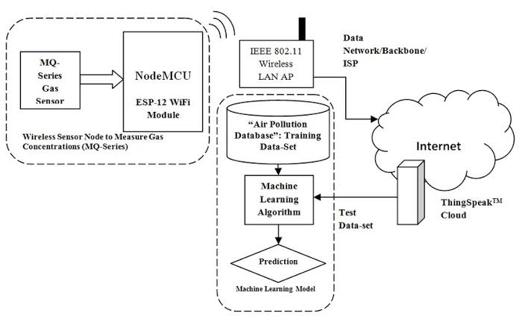

Slide 14
WORKING
Traditionally, noise monitoring has been done by measuring sound levels at predefined locations for specific periods of time.
For example, in Zurich, Switzerland, noise pollution was estimated through manual recordings of traffic noise.
The counting cars passing through in intervals of 30 min.

Slide 15
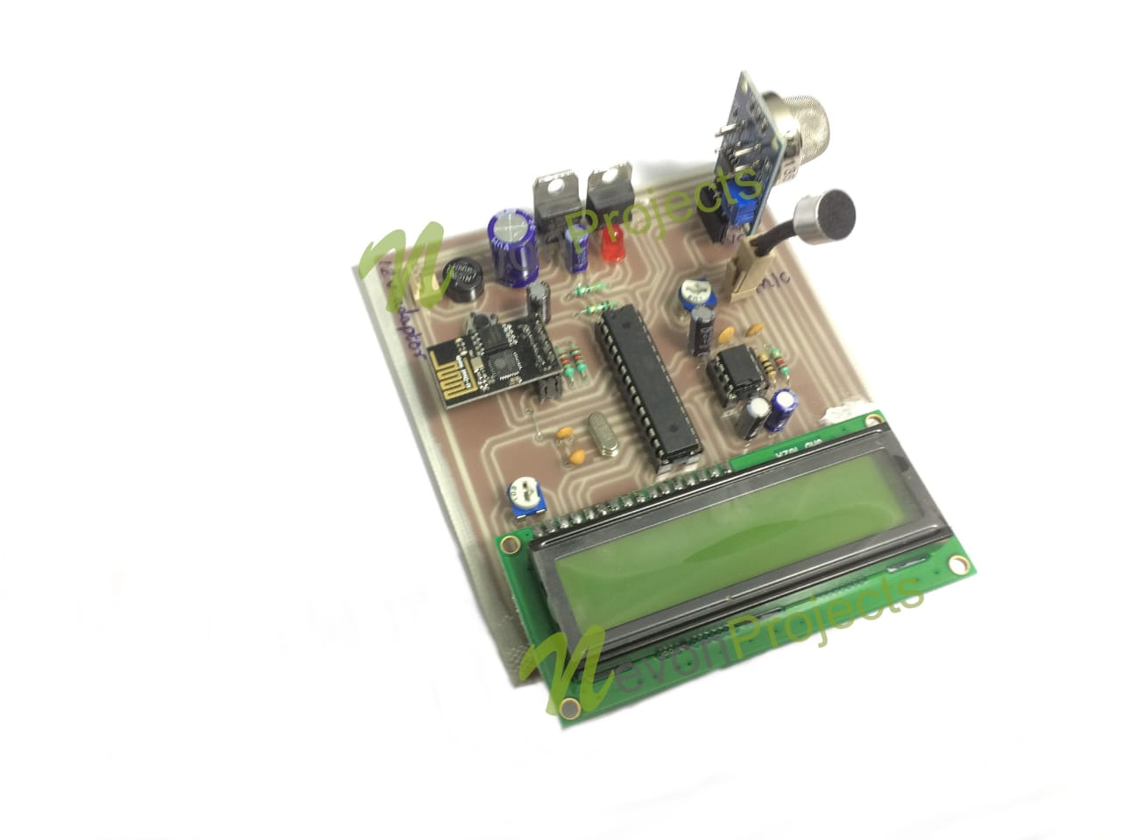
SOUND MONITORING

Slide 16
SOUND SENSOR
A sound sensor detects sound waves and converts them into electrical signals.
It combines a microphone and processing circuitry on a small board.
It measures sound intensity and produces a digital output signal using a microphone and LM393 level comparator chip.

Slide 17
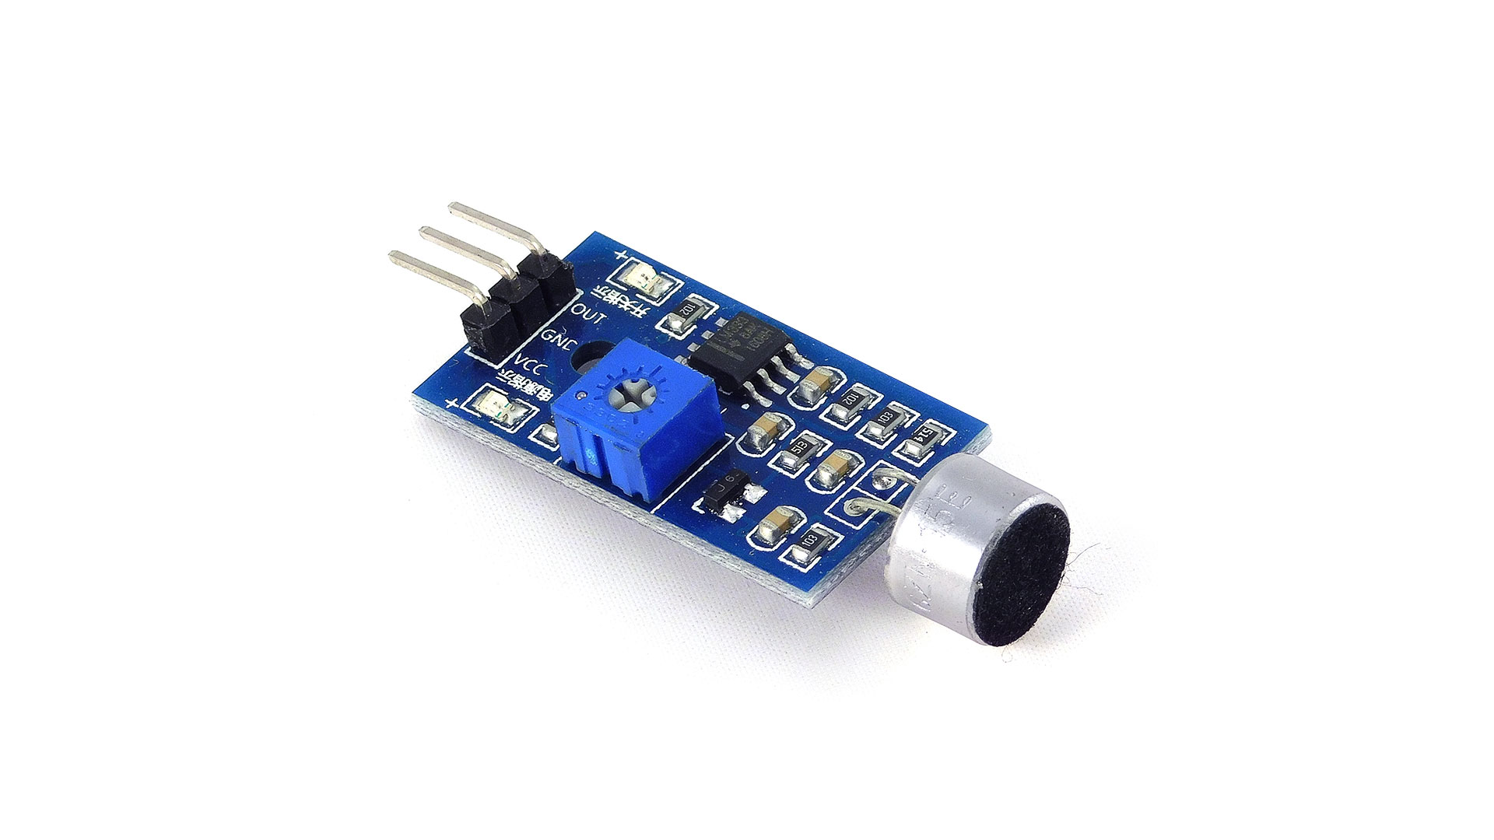

Slide 18
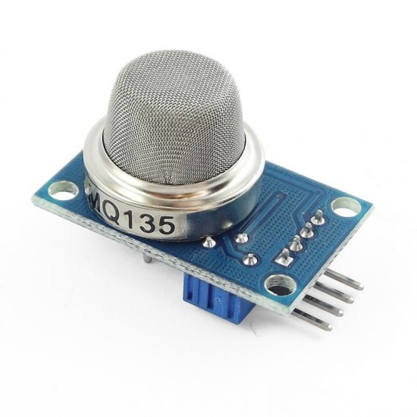
MQ-135 GAS SENSOR
The MQ 135 sensor can be implemented to detect smoke, benzene, vapors, and other hazardous gases.

Slide 19
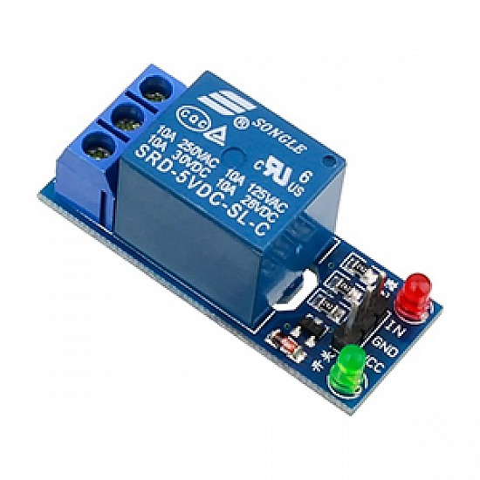
RELAY
A relay is an electronically operated switch that is remotely activated by an electromagnet which pulls a set of contacts to either make or break a circuit.

Slide 20
DESIGN PARAMETERS
Temperature
Dew point
Bulk density
Size of particles
Composition
Volumetric flow rate
Tendency of allgomorate

Slide 21
ADVANTAGES & DISADVANTAGES
Advantages:
Low initial cost
Easy to design
Low pressure drop
Low maintainance cost
Disadvantages:
Require large space
Less collection efficiency
Large size equipment

Slide 22
APPLICATIONS
Road side pollution monitoring
Industrial perimeter monitoring
Indoor air quality monitoring

Slide 23
CONCLUTION
Noise pollution can cause health problems for people and wildlife, both on land and in the sea.
From traffic noise to rock concerts, loud or inescapable sounds can cause hearing loss, stress, and high blood pressure.

Slide 24
REFERENCE
C. D. Francis C. P. Ortega A. (2009) Noise pollution changes avian communities and species interactions.Current Biology 19:1415–1419.
JP Chambers · Cited by 23 — References. L. E. Kinsler, A. R. Frey, A. B. Coppens, et al., (2000) Fundamentals of Acoustics, 4th ed., Wiley, New York, 2000. Google Scholar.

Slide 25
THANK YOU

